Slide 1
Financial
Status
Update
EASTERN WEST VIRGINIA COMMUNITY AND TECHNICAL COLLEGE
Board of Governors Meeting – January 25, 2023

Slide 2
Financial Highlights
09/30/22 Financial Statements (were emailed to members)
Cash Balances (at 12/31/22)
Budget Revisions (no revisions since last meeting)
HEERF Funds Balance (at 12/31/22)
Pending:
- Budget Scenarios (Finance Committee discussion)
- Finance Committee is to schedule a meeting.

Slide 3
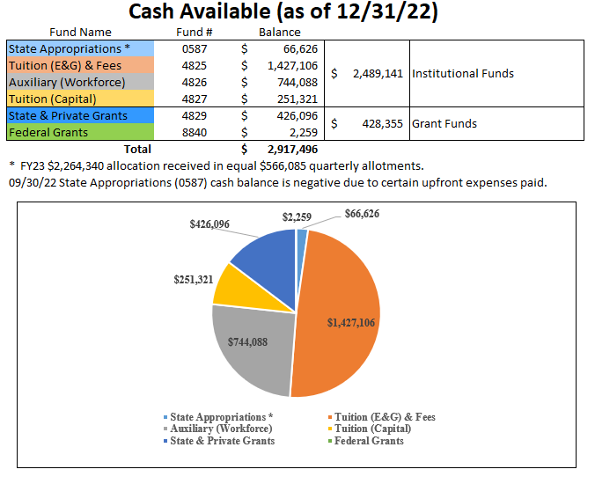

Slide 4
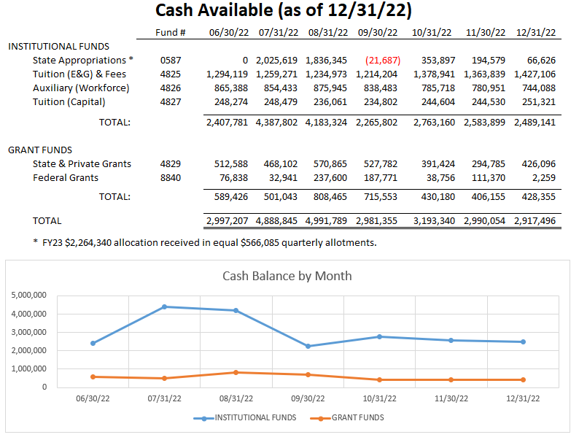

Slide 5
FY23 Budget Revisions
No budget revisions since last board meeting.

Slide 6
