Slide 1
Financial
Status
Update
EASTERN WEST VIRGINIA COMMUNITY AND TECHNICAL COLLEGE
Board of Governors Meeting – May 10, 2023

Slide 2
Financial Highlights
Cash Balances (at 04/30/23)
Budget -vs- Actual (Cash Basis) (at 04/30/23)
Budget Revisions (no revisions since 01/25/23 meeting)
HEERF Funds Balance (at 04/30/23)
Pending:
- Budget Scenarios (Finance Committee discussion)
- Finance Committee is to schedule a meeting.

Slide 3
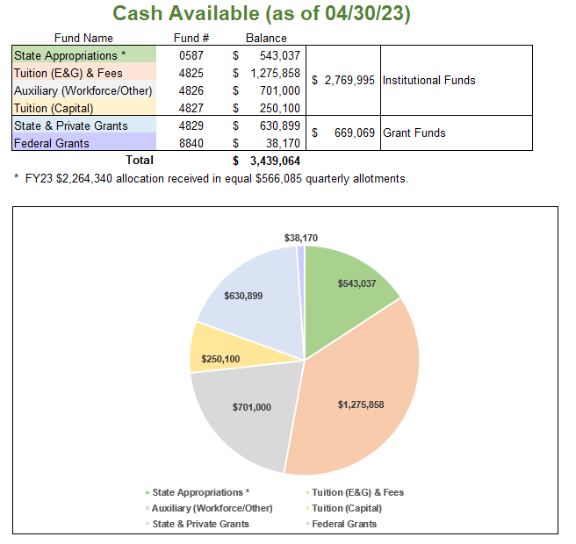

Slide 4
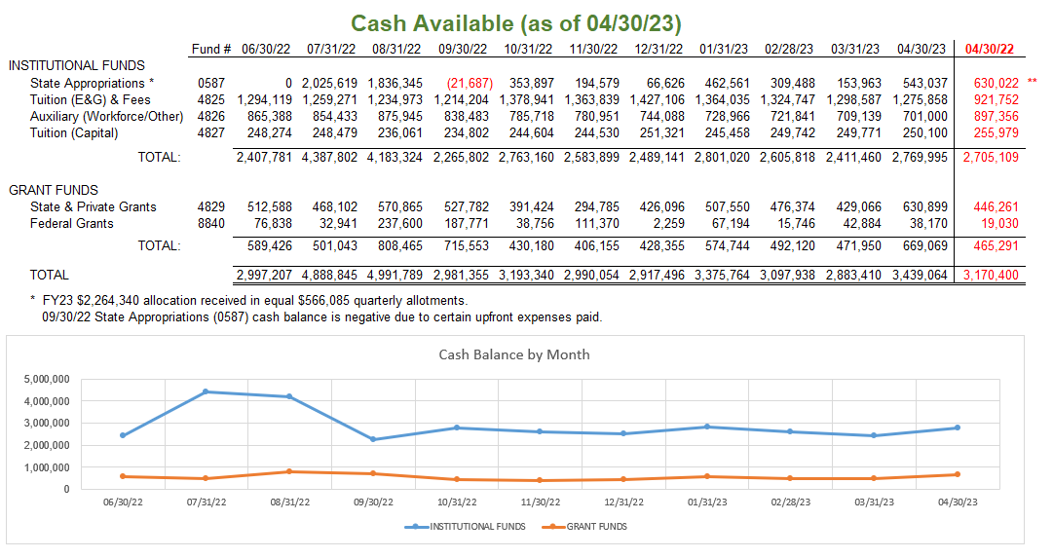

Slide 5
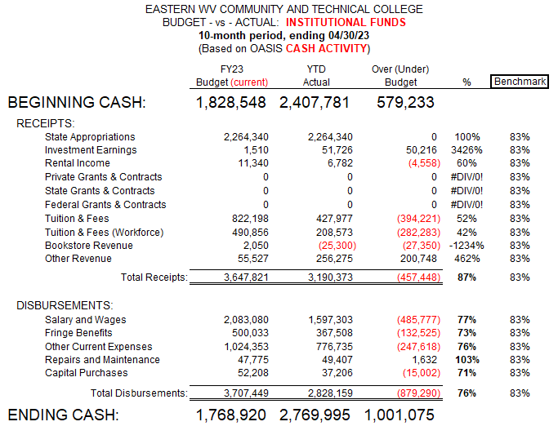

Slide 6
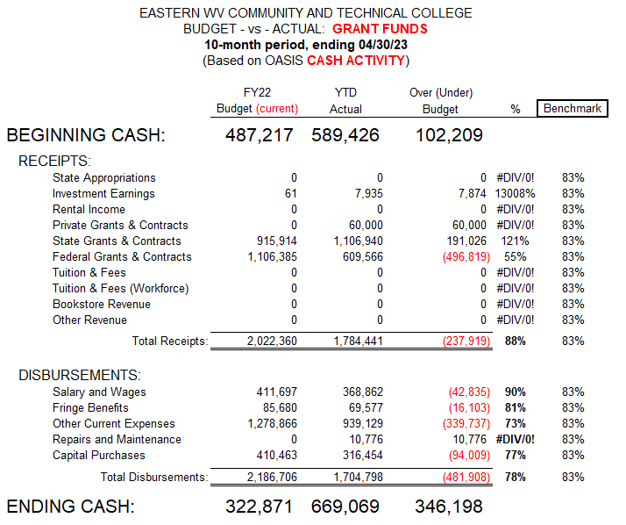

Slide 7
FY23 Budget Revisions
No budget revisions since 01/25/23 board meeting.

Slide 8
