Slide 1
Financial
Status
Update
Board of Governors Meeting – October 17, 2023

Slide 2
Financial Highlights
Cash Balances (at 09/30/23)
Budget -vs- Actual (Cash Basis) (at 09/30/23)
Current Year Actual –vs- Previous Year Actual (Cash Basis) (at 09/30/23)
Budget Revisions (for the month of 09/23)

Slide 3
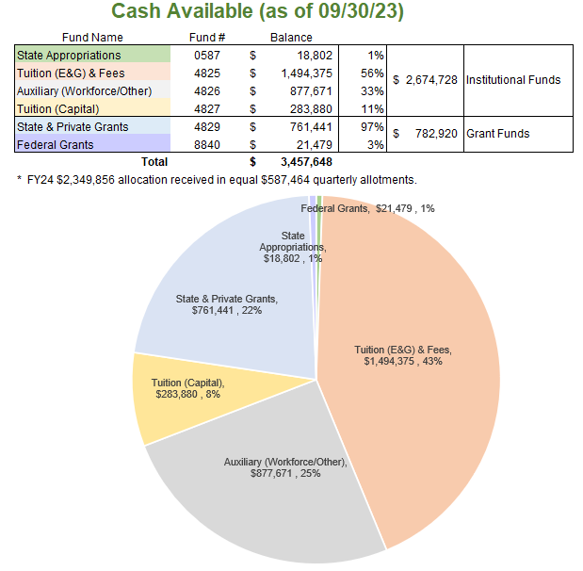

Slide 4
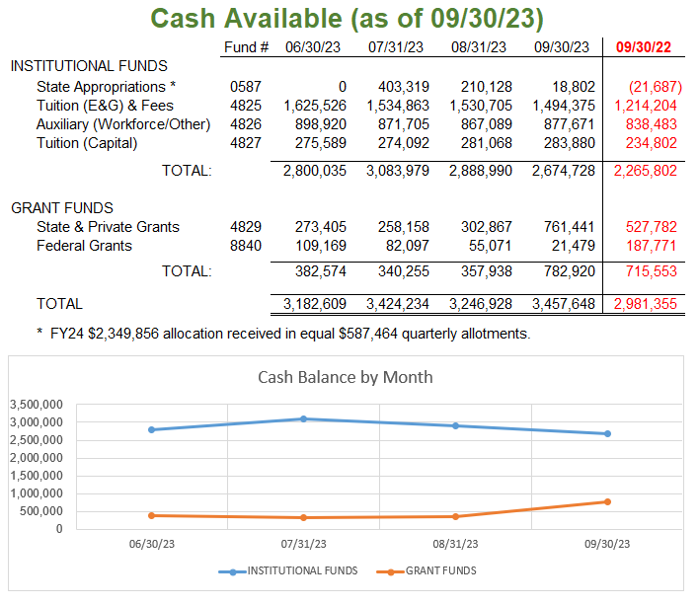

Slide 5
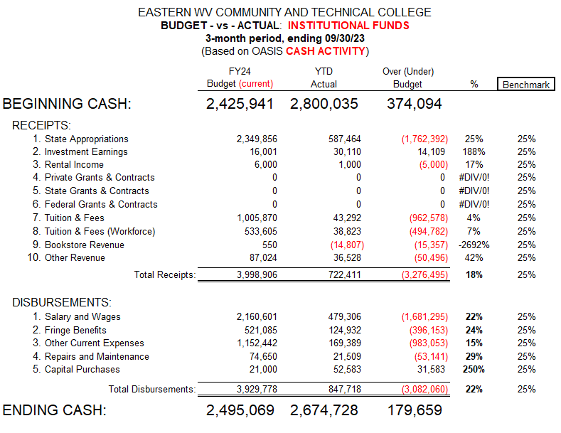

Slide 6
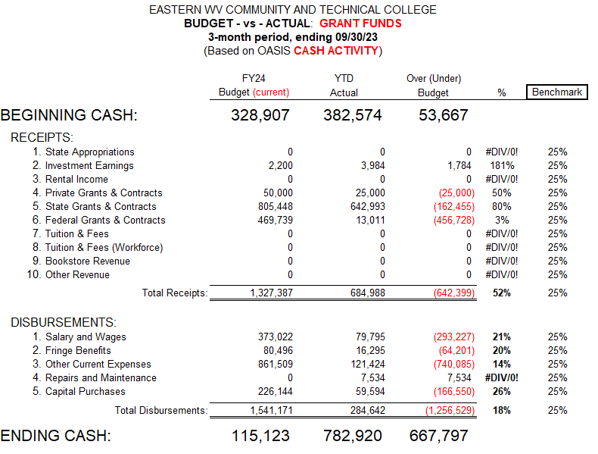

Slide 7
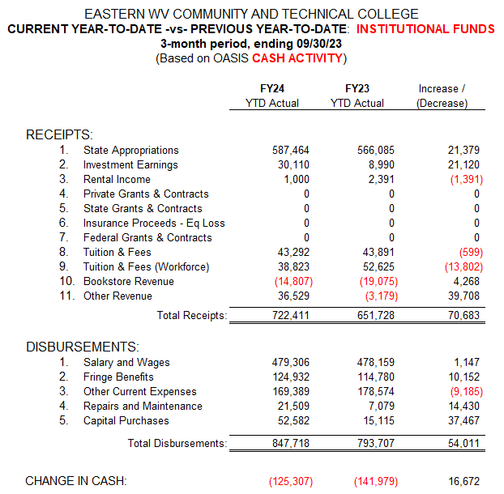

Slide 8
