Slide 1
Financial
Status
Update
EASTERN WEST VIRGINIA COMMUNITY AND TECHNICAL COLLEGE
Board of Governors Meeting – October 19, 2022

Slide 2
Financial Highlights
FY22 Audit Status
Audit is complete. Marie Long (Suttle & Stalnaker) to present at November meeting.
Cash Balances (at 09/30/22)
Budget –vs- Actual (cash basis at 09/30/22)
Budget Revisions
HEERF Funds Balance (at 09/30/22)
Pending:
- Budget Scenarios (Finance Committee discussion)
- Finance Committee is to schedule a meeting.

Slide 3
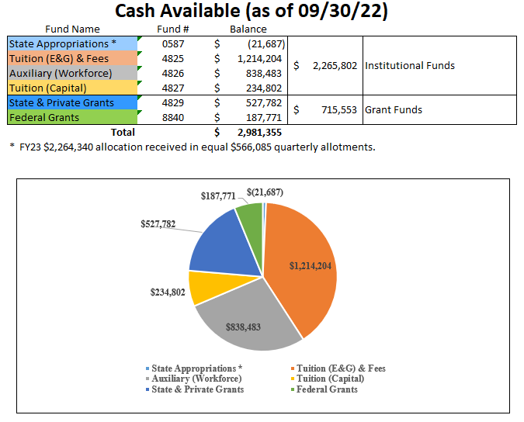

Slide 4
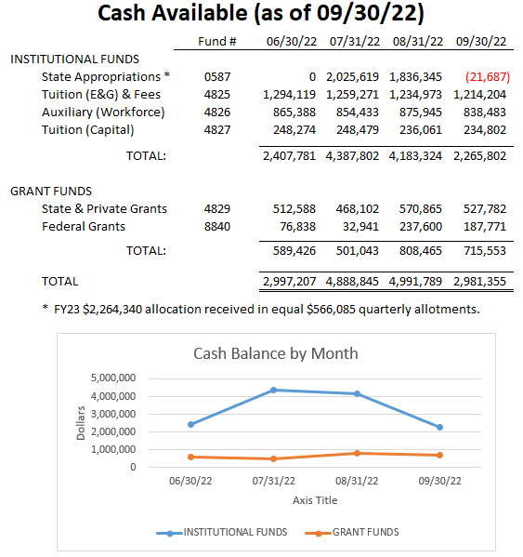

Slide 5
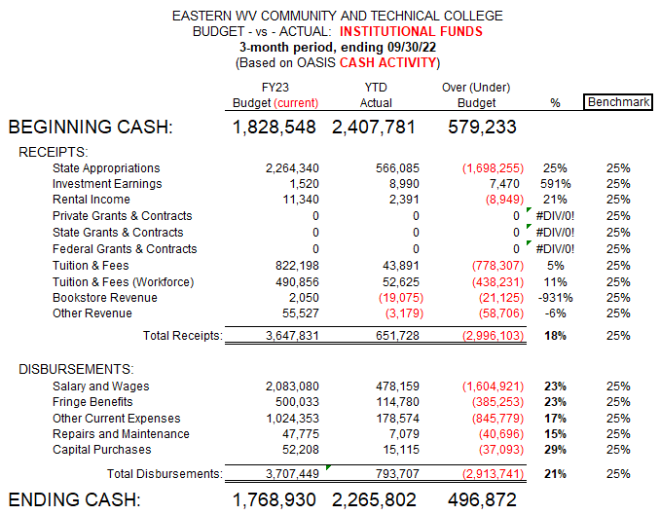

Slide 6
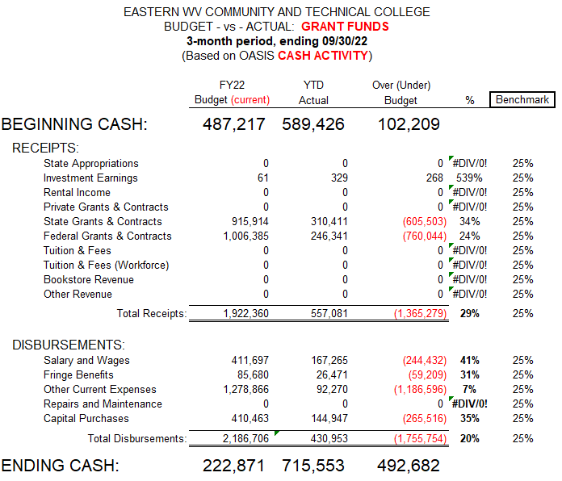

Slide 8
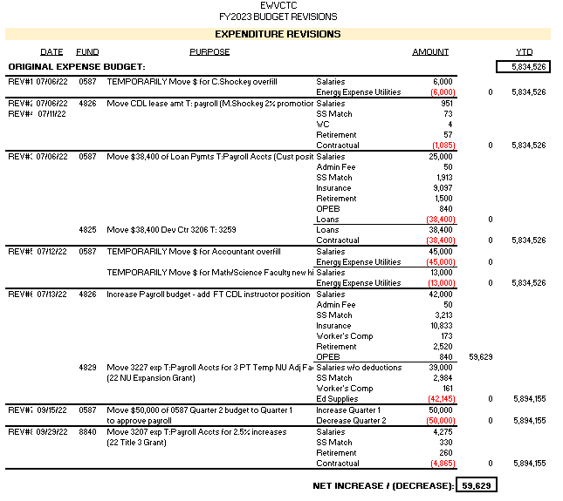

Slide 9
