Slide 1
Financial
Status
Update
EASTERN WEST VIRGINIA COMMUNITY AND TECHNICAL COLLEGE
Board of Governors Meeting – November 16, 2022

Slide 2
Financial Highlights
FY22 Financial Statement Presentation
Marie Long (Suttle & Stalnaker)
Cash Balances (at 10/31/22)
Budget –vs- Actual (cash basis at 10/31/22)
Budget Revisions (no revisions since last meeting)
HEERF Funds Balance (at 10/31/22)
Pending:
- Budget Scenarios (Finance Committee discussion)
- Finance Committee is to schedule a meeting.

Slide 3
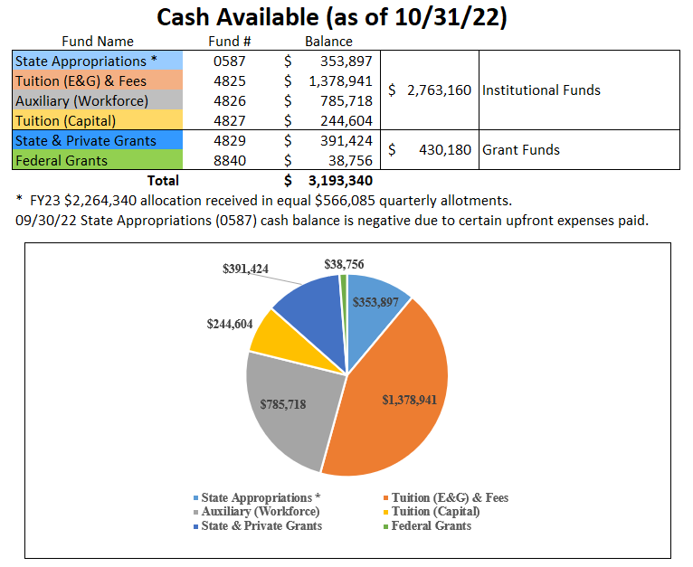

Slide 4
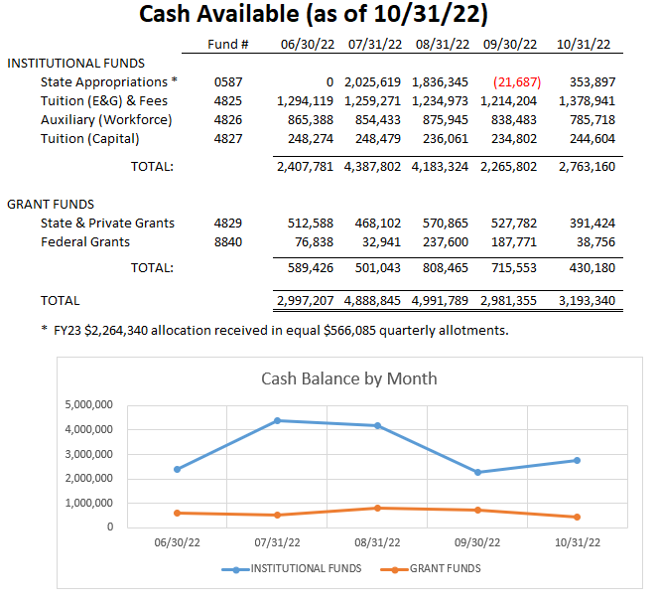

Slide 5
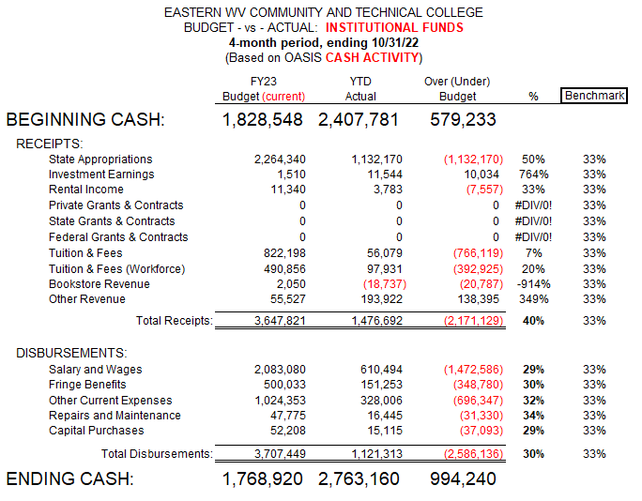

Slide 6
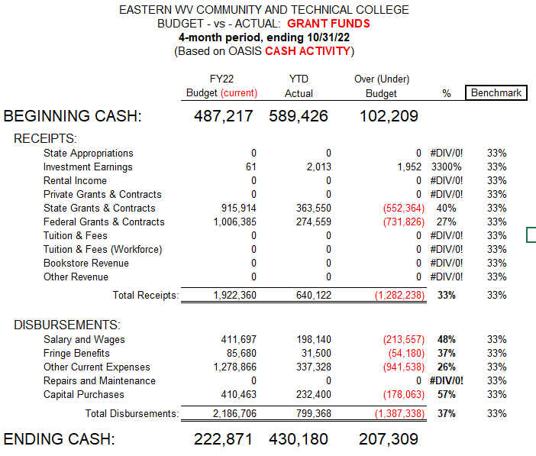

Slide 7
