Slide 1
Financial
Status
Update
EASTERN WEST VIRGINIA COMMUNITY AND TECHNICAL COLLEGE
Board of Governors Meeting – January 19, 2022

Slide 2
Financial Highlights
Cash Balances (at 12/31/21)
Budget-vs-Actual “Cash” Report (at 12/31/21)
Cares Funding Balances (at 12/31/21)
- $291,500 Emergency Funds distributed to students for FALL 21 from 21 ARPA (HERFF 3).
FY23 Budget prep to start in 02/22
FY17 US Department of Labor America’s Promise $3,616,108 federal grant ended 12/31/21.
Pending:
- Current Year-vs-Previous Year “Cash” Report
- FY22 Budget Scenarios (Finance Committee discussion)
- On hold until budget is reviewed

Slide 3
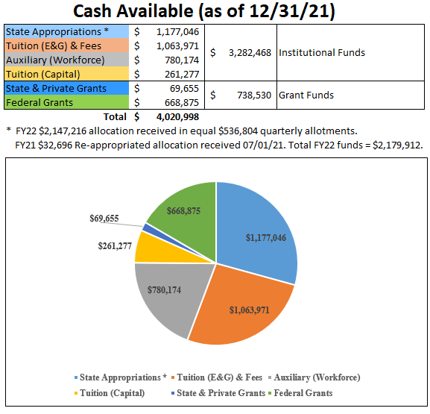

Slide 4
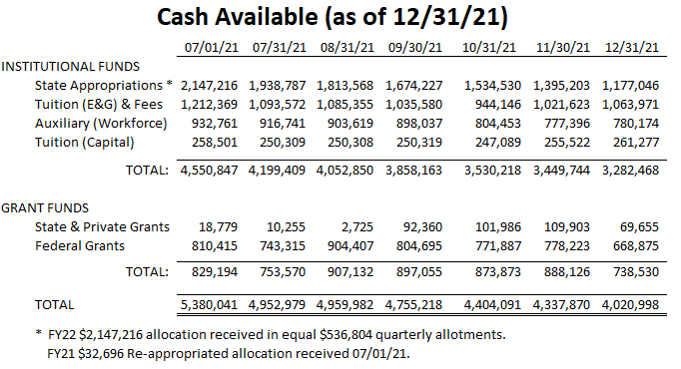

Slide 5
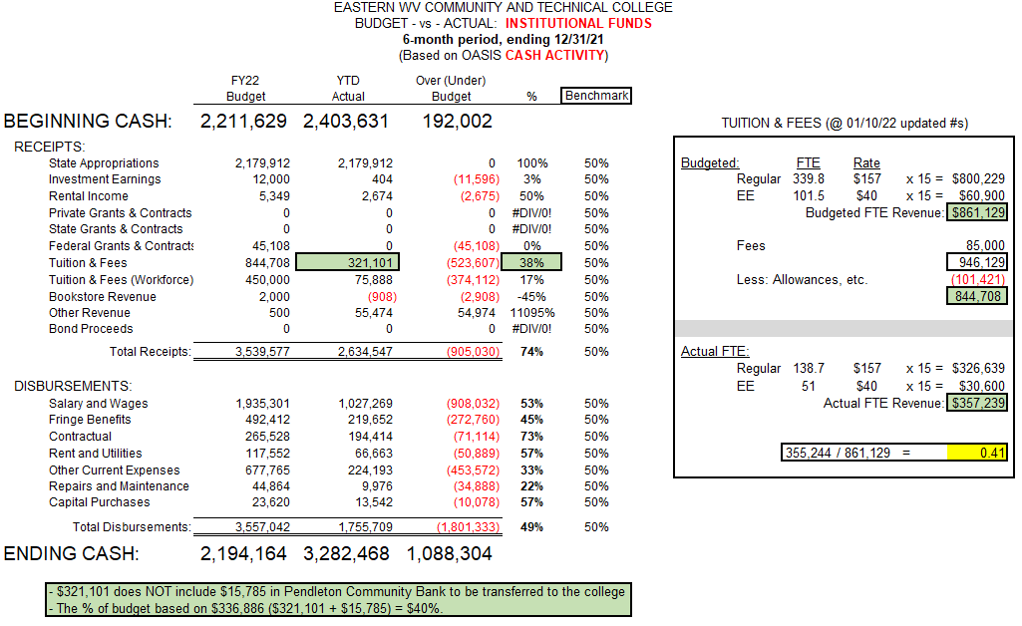

Slide 6
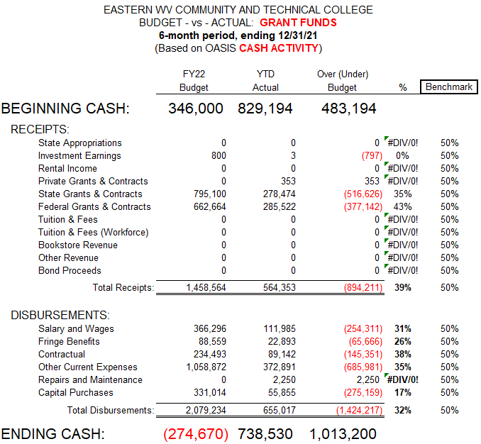

Slide 7
