Slide 1
Financial
Status
Update
EASTERN WEST VIRGINIA COMMUNITY AND TECHNICAL COLLEGE
Board of Governors Meeting – April 20, 2022

Slide 2
Cares (HEERF)
- $117,000 projected unused funds at 06/30/22.
- Applied for $450,000 additional HEERF funds.
- 03/31/22 Quarterly Institutional Report filed and posted to website.
- 03/31/22 Quarterly Student Distributions posed to website.
FY23 Budget
- Review and approval
- Due to WV State Budget Office 05/02/22.
Pending:
- Current Year-vs-Previous Year “Cash” Report
- FY22 Budget Scenarios (Finance Committee discussion) On hold until budget is reviewed.

Slide 3
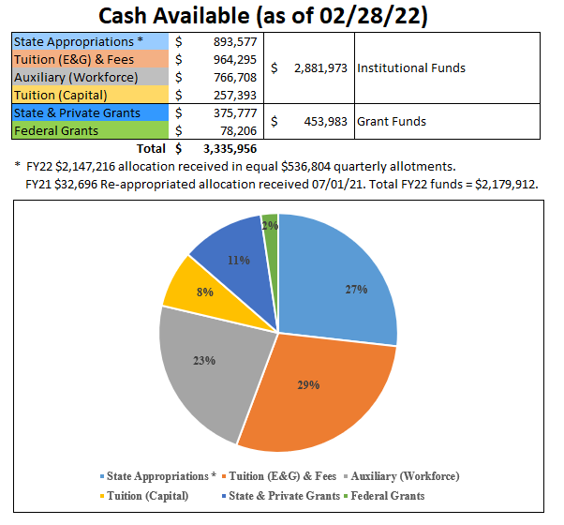

Slide 4
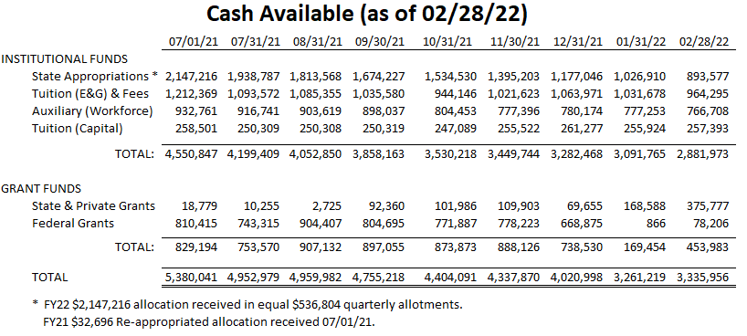

Slide 5
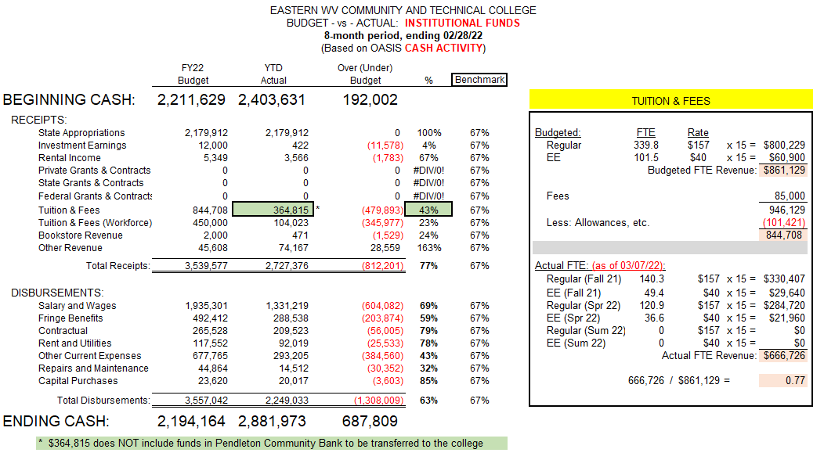

Slide 6
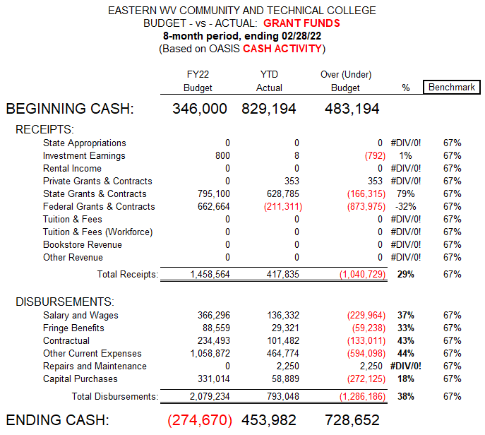

Slide 7
