Slide 1
Financial
Status
Update
EASTERN WEST VIRGINIA COMMUNITY AND TECHNICAL COLLEGE
Board of Governors Meeting – June 21, 2023

Slide 2
Financial Highlights
Cash Balances (at 05/31/23)
Budget -vs- Actual (Cash Basis) (at 05/31/23)
Current Year Actual –vs- Previous Year Actual (Cash Basis) (at 05/31/23)
Budget Revisions (Fund 4829 revised 05/18/23)
HEERF Funds Balance (at 05/31/23)

Slide 3
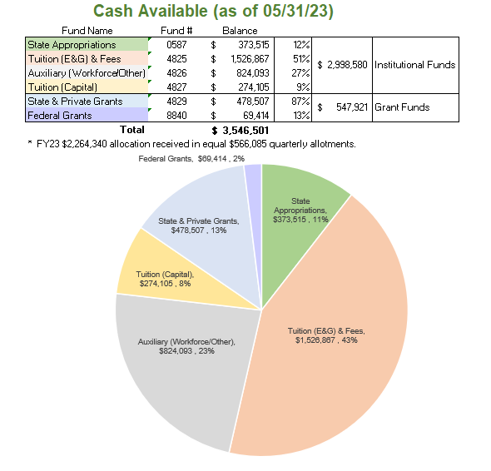

Slide 4
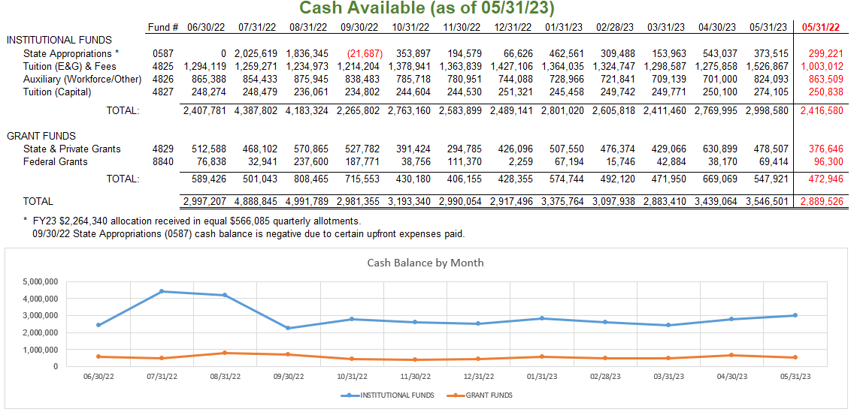

Slide 5
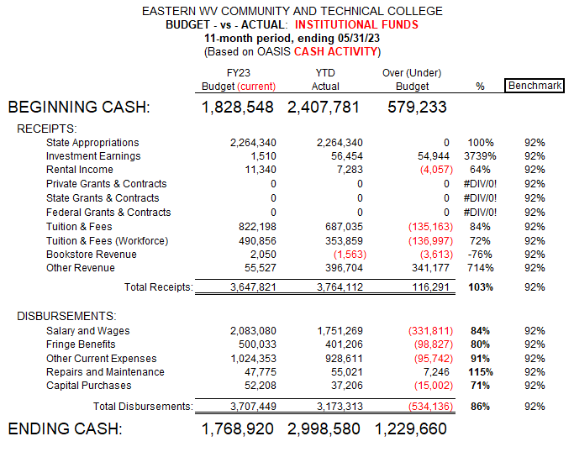

Slide 6
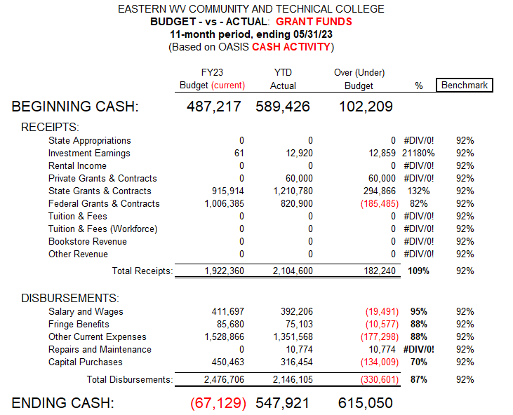

Slide 7
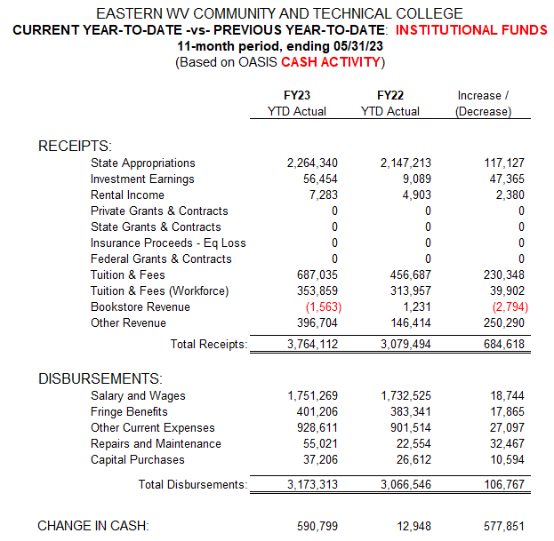

Slide 8
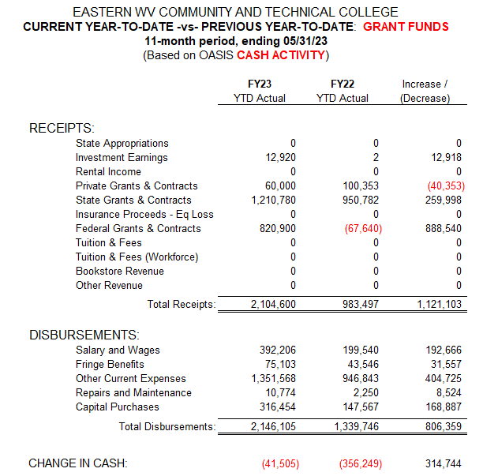

Slide 9
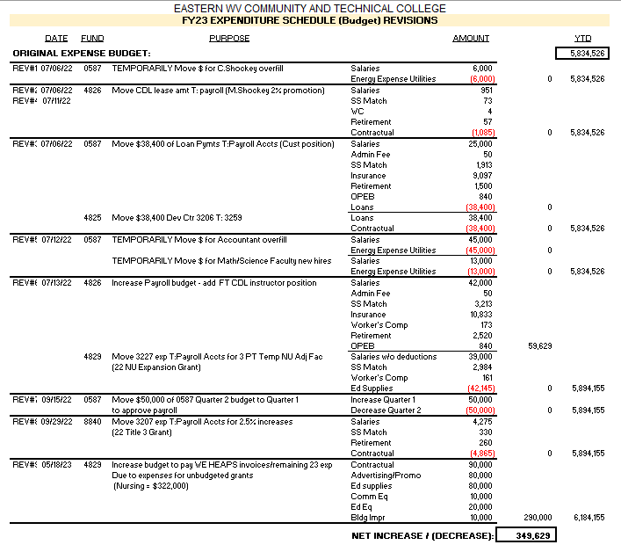
FY23 Budget Revisions

Slide 10
