Slide 1
Financial
Status
Update
EASTERN WEST VIRGINIA COMMUNITY AND TECHNICAL COLLEGE
Board of Governors Meeting – July 19, 2023

Slide 2
Financial Highlights
Cash Balances (at 06/30/23)
Budget -vs- Actual (Cash Basis) (at 06/30/23)
Current Year Actual –vs- Previous Year Actual (Cash Basis) (at 06/30/23)
Budget Revisions
HEERF Funds Balance (at 06/30/23)

Slide 3
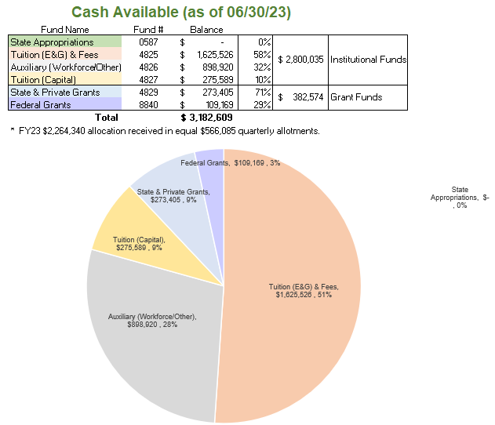

Slide 4
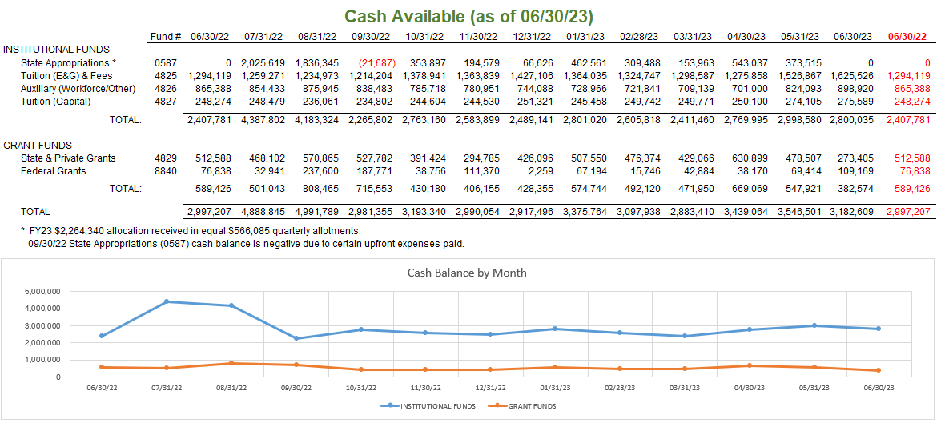

Slide 5
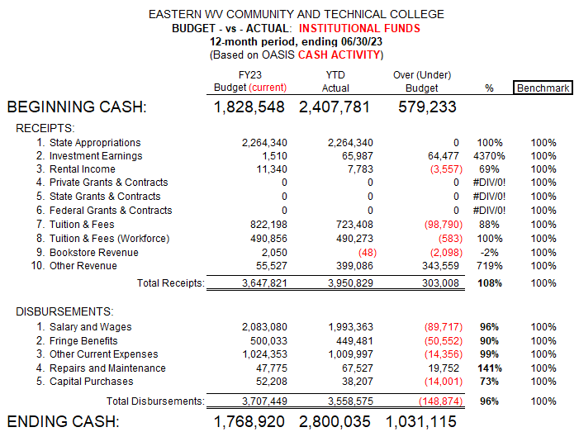

Slide 6
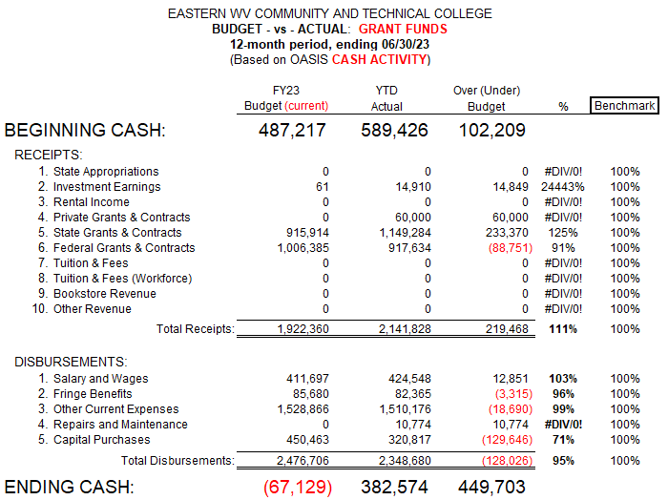

Slide 7
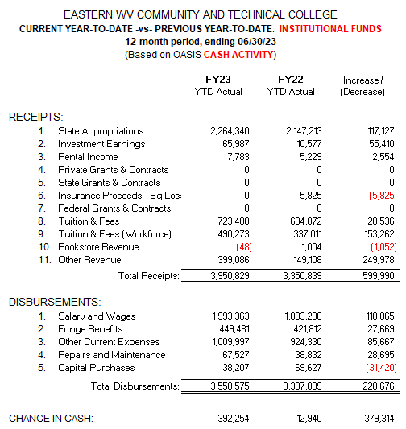

Slide 8
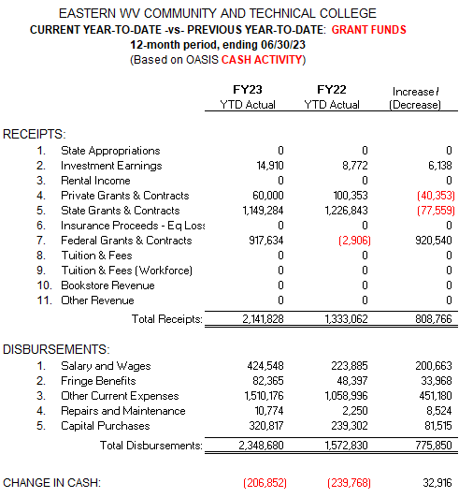

Slide 9
FY23 Budget Revisions No budget revisions since 06/21/23 BOG meeting.

Slide 10
