Slide 1
Financial
Status
Update
Board of Governors Meeting – July 17, 2024
REVISED 08/21/24 (to fix Slide #7, Receipts, Line 11 Inc/Dec Amt)

Slide 2
Financial Highlights
Cash Balances (at 06/30/24)
Budget -vs- Actual (Cash Basis) (at 06/30/24)
Current Year Actual –vs- Previous Year Actual (Cash Basis) (at 06/30/24)
Budget Revisions (for the month of 06/24)

Slide 3
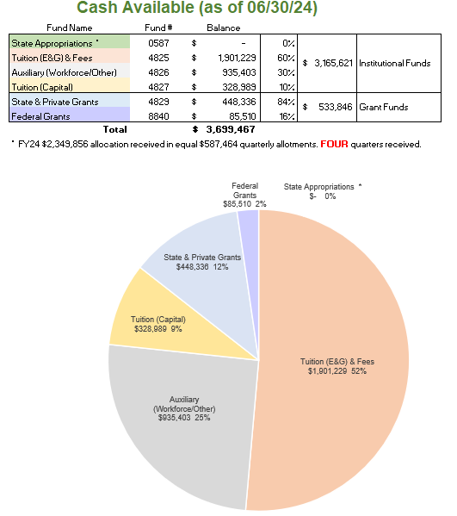

Slide 4
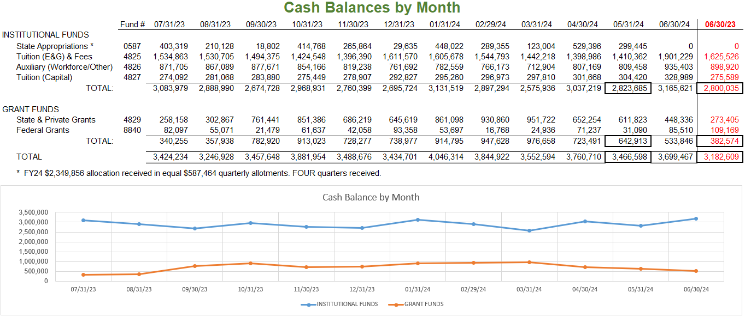

Slide 5
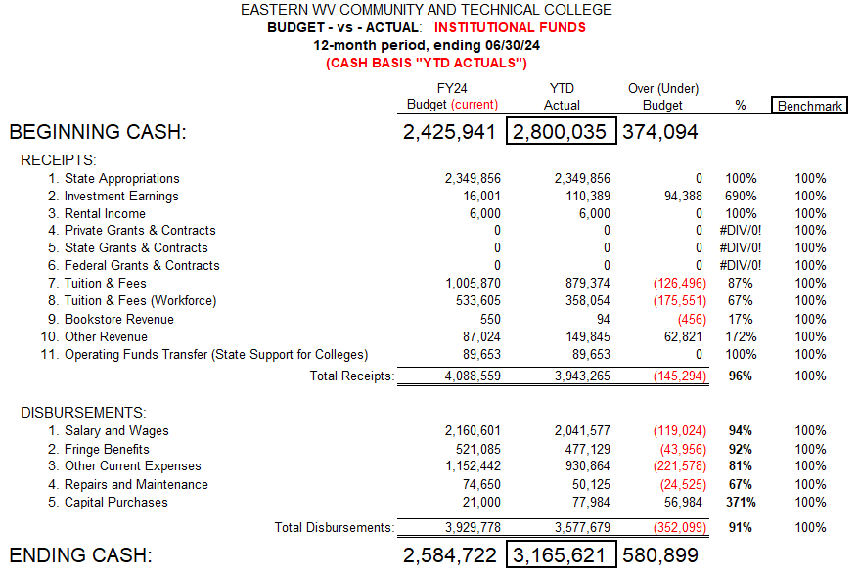

Slide 6
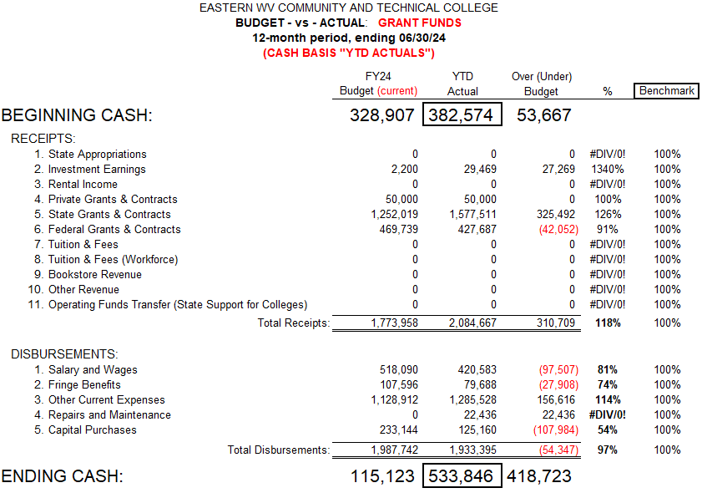

Slide 7
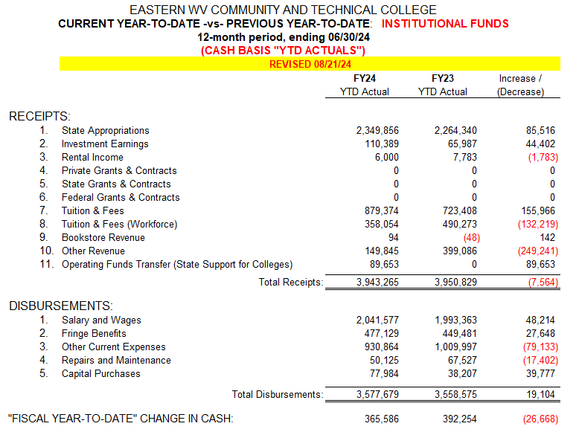

Slide 8
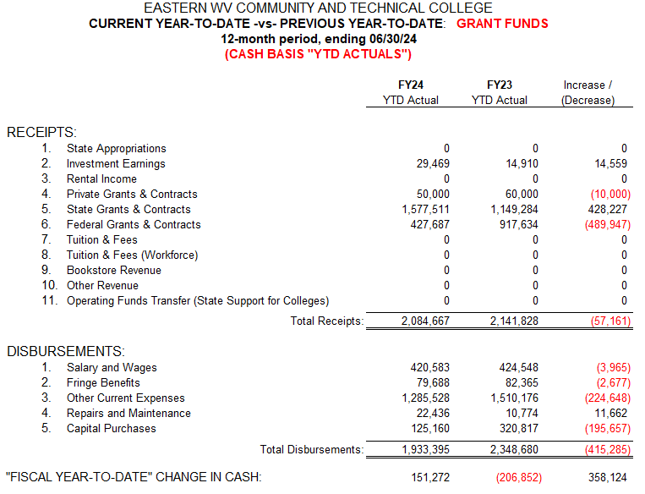

Slide 9
