Slide 1
Financial
Status
Update
Board of Governors Meeting – August 21, 2024

Slide 2
Financial Highlights
Cash Balances (at 07/31/24)
Budget -vs- Actual (Cash Basis) (at 07/31/24)
Current Year Actual –vs- Previous Year Actual (Cash Basis) (at 07/31/24)
Budget Revisions (for the month of 07/24)

Slide 3
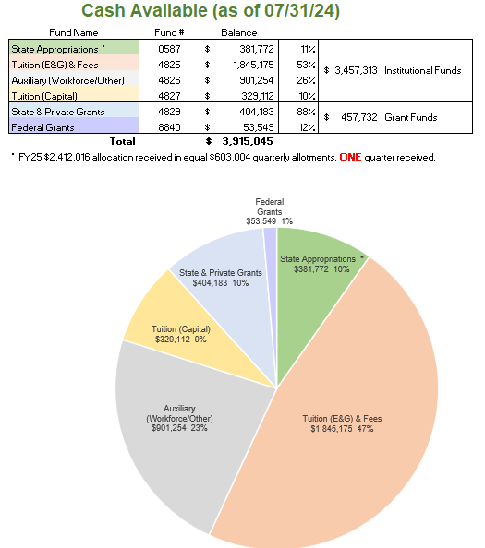

Slide 4
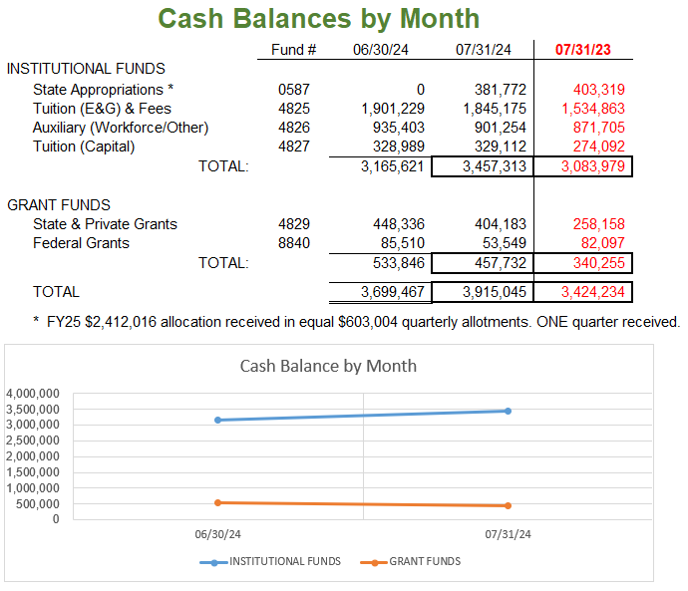

Slide 5
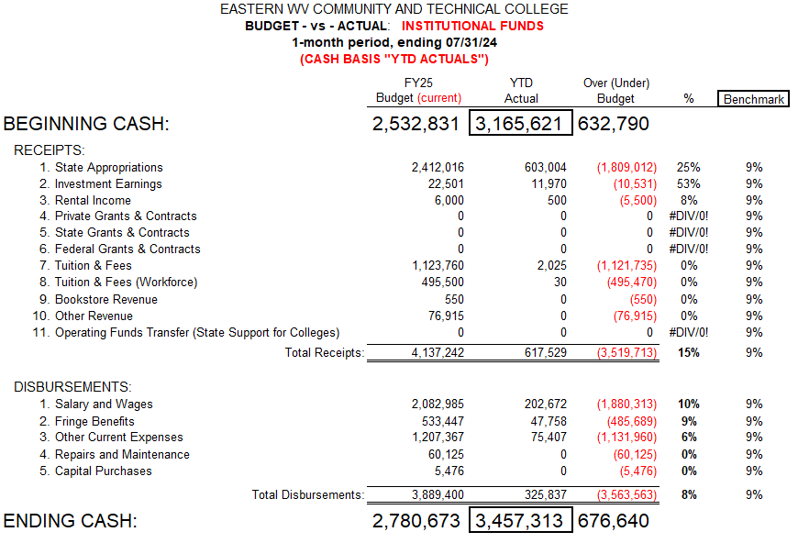

Slide 6
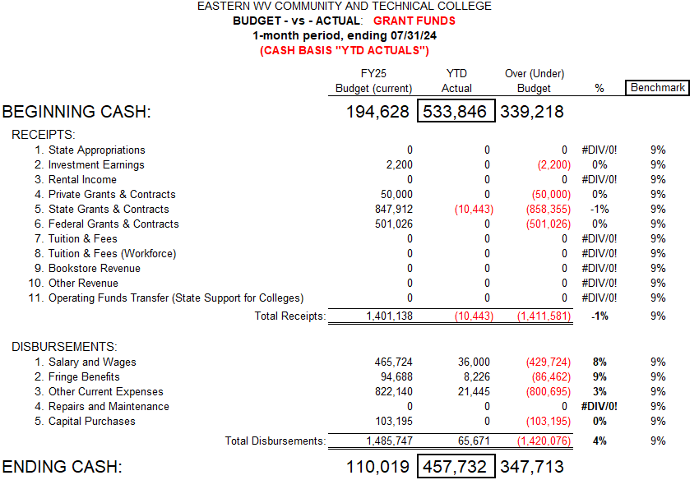

Slide 7
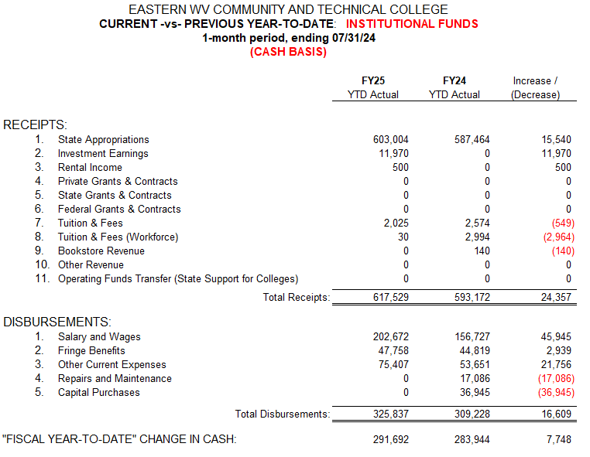

Slide 8
