Slide 1
Financial
Status
Update
Board of Governors Meeting – September 20, 2023

Slide 2
Financial Highlights
Cash Balances (at 08/31/23)
Budget -vs- Actual (Cash Basis) (at 08/31/23)
Current Year Actual –vs- Previous Year Actual (Cash Basis) (at 08/31/23)
Budget Revisions (as of 08/31/23)

Slide 3
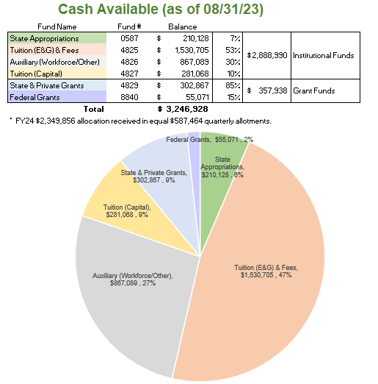

Slide 4
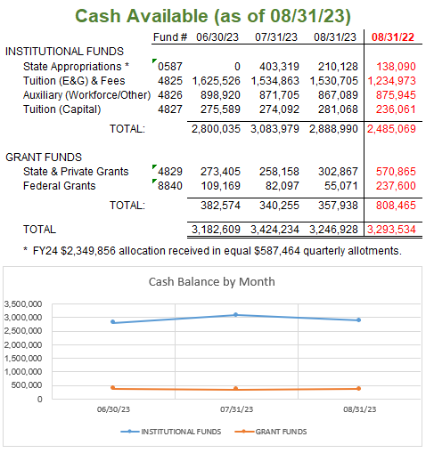

Slide 5
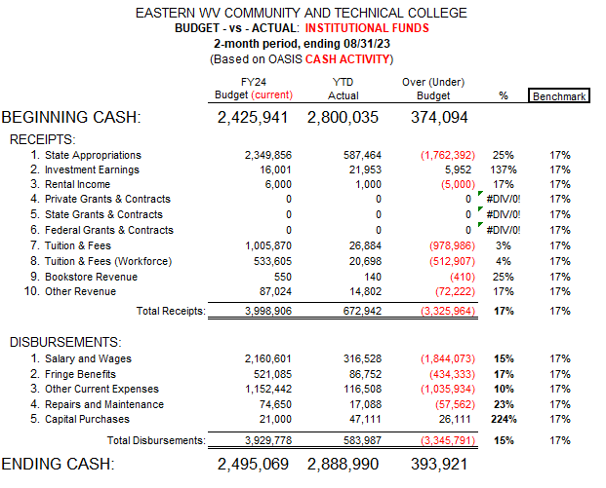

Slide 6
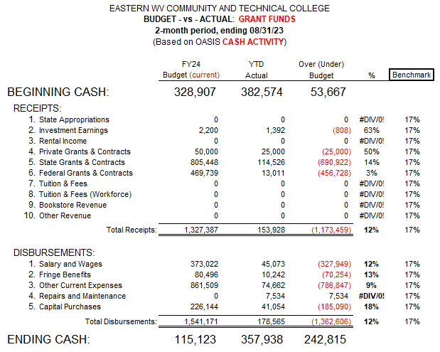

Slide 7
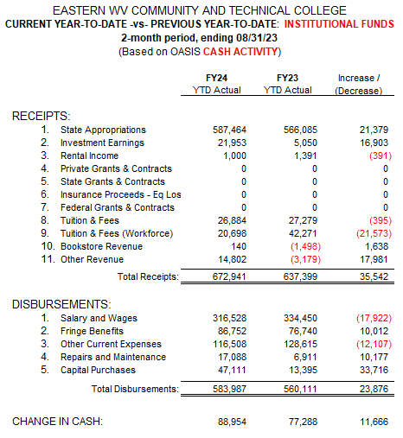

Slide 8
