Slide 1

Financial
Status
Update
Board of Governors Meeting – September 22, 2021

Slide 2
Financial Highlights
FY21 Audit Schedule
Final Work: Wrapping up
Draft Financials: Due September 15 (submitted)
Final Financials: Due October 15
FY23 Appropriation Request submitted
FY22 Budget Scenarios (Finance Committee discussion)
  On hold until budget is reviewed

Slide 3
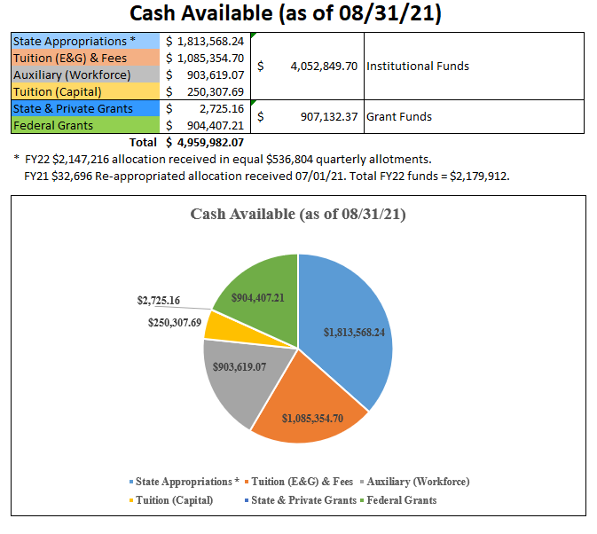

Slide 4
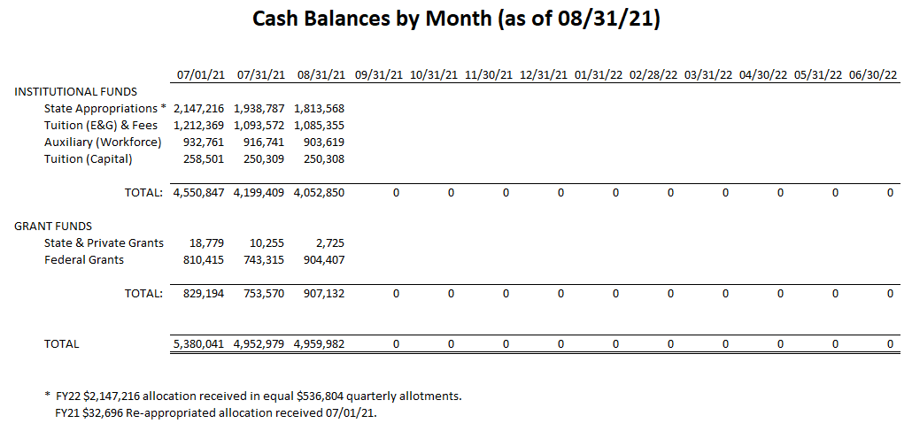

Slide 5
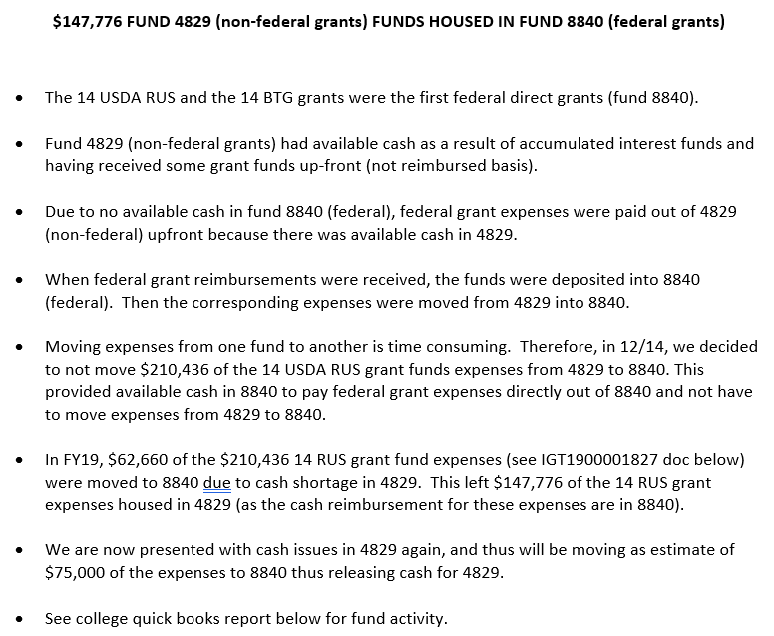

Slide 7
