Slide 1
Financial
Status
Update
EASTERN WEST VIRGINIA COMMUNITY AND TECHNICAL COLLEGE
Board of Governors Meeting – October 20, 2021

Slide 2
Financial Highlights
FY21 Audit: Suttle & Stalnaker presentation
Cash Balances (at 09/30/21)
Budget-vs-Actual Cash Activity (at 09/30/21)
Cares Funding Balances (at 10/12/21)
PENDING:
Current Year-vs-Previous Year Cash Activity (at 09/30/21)
FY22 Budget Scenarios (Finance Committee discussion)
On hold until budget is reviewed

Slide 3
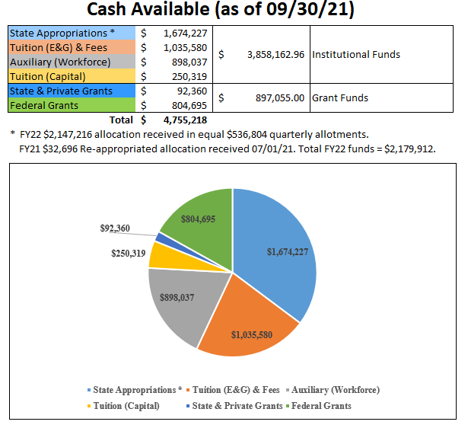

Slide 4
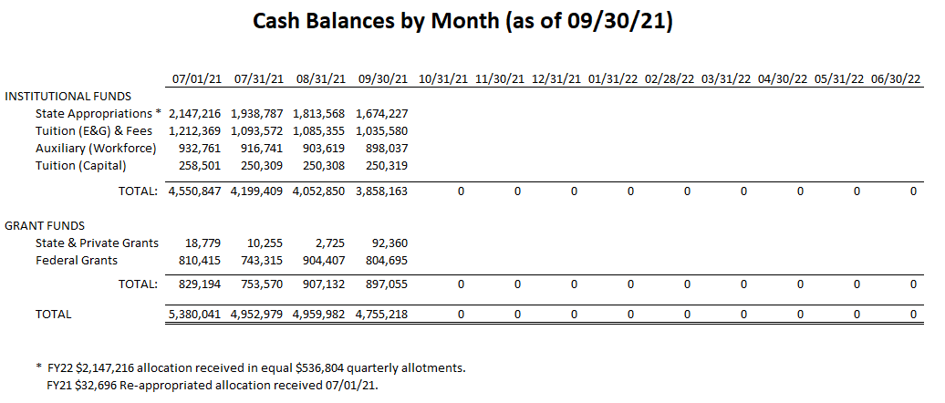

Slide 5
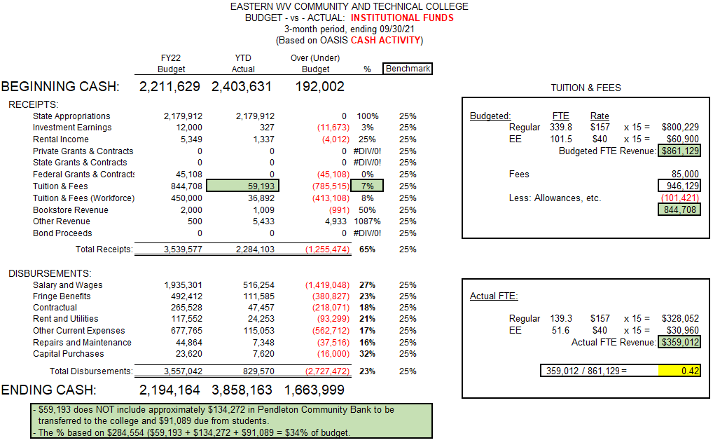

Slide 6
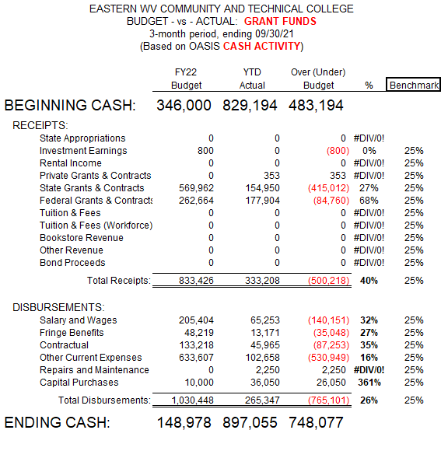

Slide 7
